Slide 1

Organization: BEUMER Group
Intern Name: Mandeep Rana
Reporting Managers: Mr. Kannan (Digitalization), Mr. Shivam Singh (Automation/Networking)
Internship Duration: 12 Weeks (6 Weeks Digitalization + 6 Weeks Automation)

Slide 2


1. Executive Summary
This report presents a comprehensive overview of a 12-week internship program at BEUMER Group, divided into Digitalization (6 weeks) and Automation & IT Infrastructure (6 weeks). The internship combined theoretical learning with hands-on industrial projects focused on Industrial IoT, Digital Twins, Predictive Maintenance, Networking, Server Infrastructure, and Full-Stack Software Development.
The internship resulted in multiple operational, demo-ready, and production-grade projects, strengthening practical skills aligned with BEUMER’s digital transformation and automation initiatives.

Slide 3
Week-wise Training & Hands-on Progress
Week 1–2: Foundation & IoT Connectivity
Studied ongoing BEUMER digital projects (BHS, Bucket Elevator, Fillpac)
Learned sensor types, gateways, and edge devices
Implemented Node-RED + MQTT simulated data streaming
Understood limitations of virtual sensor data
Week 3–4: Data & AI/ML
Implemented Python-based sensor data generators
Built complete pipeline: Python → MQTT → Elasticsearch → Kibana
Designed Kibana dashboards for real-time visualization
Learned ML fundamentals and predictive maintenance use cases
Week 5–6: Application & Assessment
Studied cloud & edge platforms (Azure, AWS, On-Prem)
Security and data governance in industrial systems
Group project presentations and final assessments

Slide 4
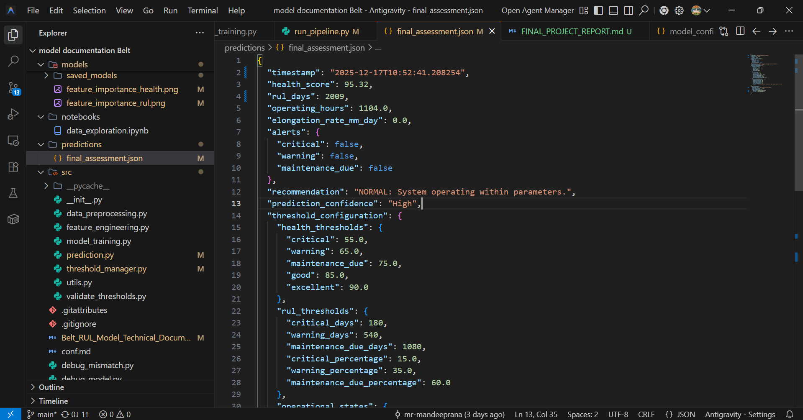
Company Project – Belt RUL Prediction Model (Ongoing)
Project Type
Company Live Project – Predictive Maintenance
Objective
To predict Remaining Useful Life (RUL) of bucket elevator steel cord belts and enable proactive maintenance.
Methodology
Random Forest ML model
1.6M+ sensor readings
700+ engineered features
Hybrid ML + engineering rule-based approach
Key Outputs
Health Score: 95.32%
Predicted RUL: 2009 Days
Model Accuracy (R²): > 0.99
Team Members:Mandeep Rana,Anne Sarvan
Guidance:Mr.Kannan Sir

Slide 5
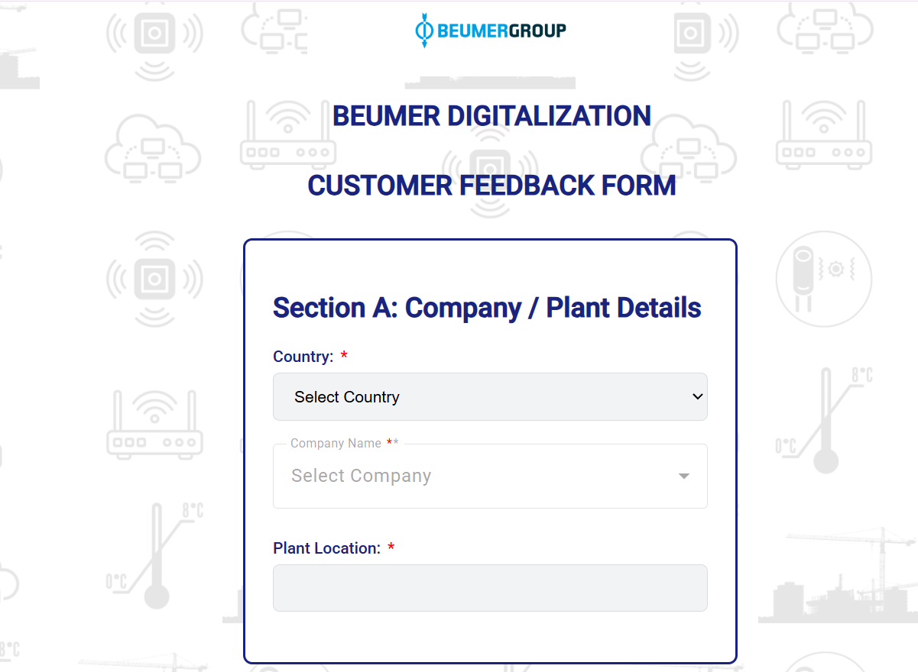
Company Project – Customer Feedback System
Project Objective
Digitize and centralize customer feedback collection across global BEUMER plant locations with a secure, deployable web solution.
System Architecture
React (Frontend – Netlify) → Node.js & Express (Backend API) → MongoDB Atlas (Cloud Database)
Key Technical Contributions
Resolved backend runtime and deployment errors
Improved API logic for validation, sanitization, and error handling
Verified correct MongoDB integration (live insert & fetch testing)
Successfully deployed backend on a free cloud platform for testing
Key Features & Impact
Dynamic, validation-driven feedback forms
Secure REST APIs with environment-based configuration
Centralized feedback storage with timestamps
70–80% faster submissions, error rate <2%
P
Project Status:Deployed
https://feedbackformbeumergroup.netlify.app/

Slide 6
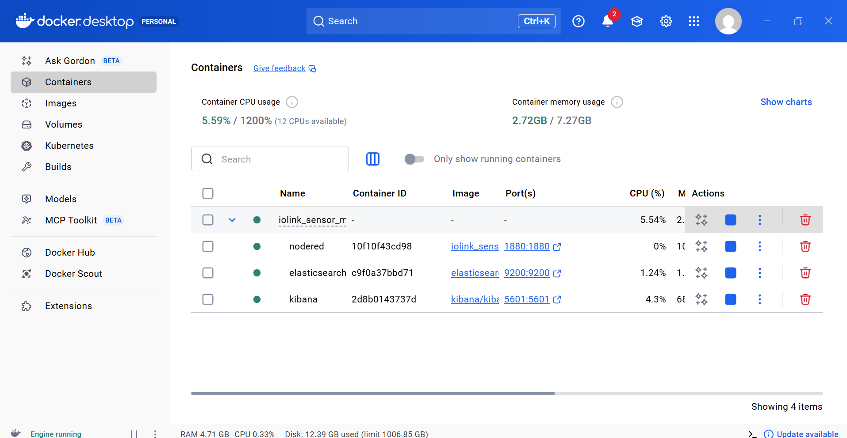
Core Digitalization Project – IO-Link Sensor Monitoring System
Project Objective
To design a scalable, containerized real-time monitoring system for IO-Link industrial sensors using a Digital Twin approach.
System Architecture
IO-Link Sensors → Node-RED → Elasticsearch → Kibana Dashboard
Technical Stack
Node-RED (Data ingestion)
Elasticsearch (Time-series storage)
Kibana (Visualization)
Docker & Kubernetes (Deployment)
Key Features
Real-time ultrasonic & vibration monitoring
Alerting based on ISO thresholds
Historical trend analysis
Dockerized & Kubernetes-ready
Deployment
Docker Image: docker pull mandeeprana1/iolink_sensor_monitoring:latest

Slide 7
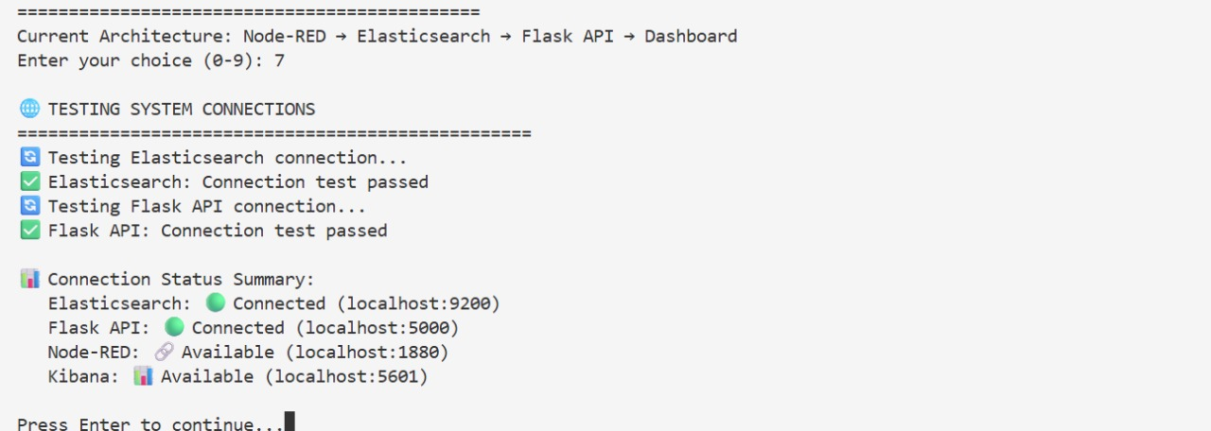
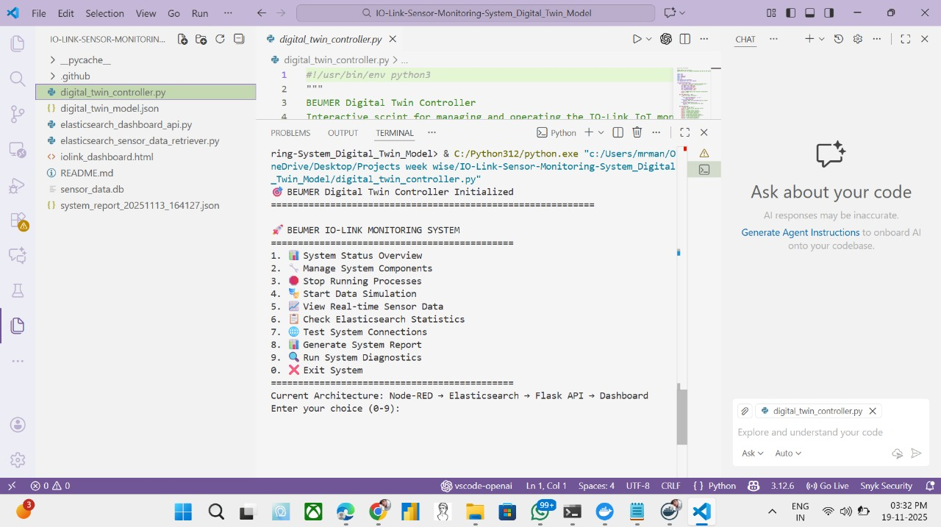
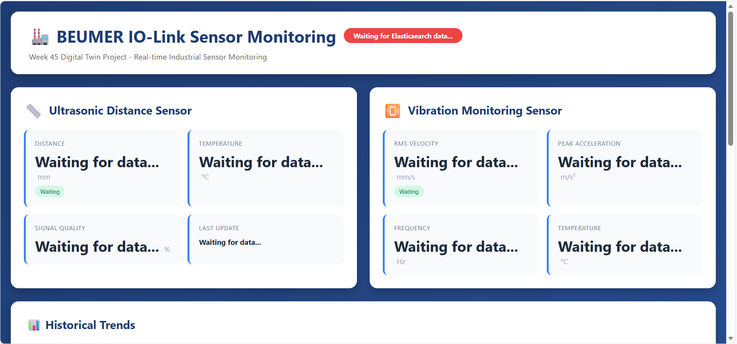
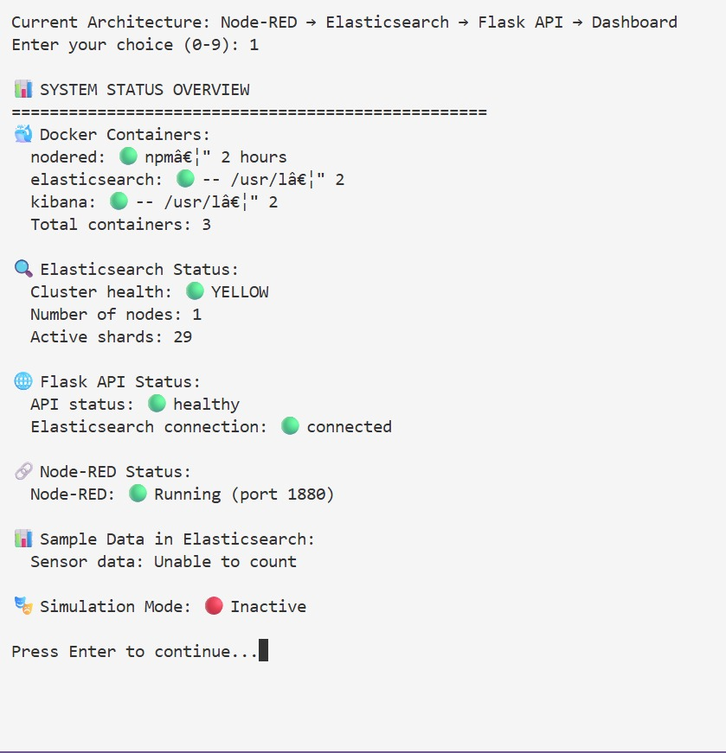
IO-Link Sensor Monitoring System
Digital Twin–Based Industrial IoT
Overview Real-time monitoring of IO-Link ultrasonic and vibration sensors using Node-RED, Elasticsearch, and Kibana, deployed with Docker & Kubernetes.
Architecture Sensors → Node-RED → Elasticsearch → Kibana → Dashboard
Key Highlights
Live sensor data (2-sec updates)
Alerts & historical trends
Scalable containerized deployment
Status ✅ Operational | ✅ Demo Ready
GitHub:https://github.com/mr-mandeeprana/IO-Link-Sensor-Monitoring-System_Digital_Twin_Model.git

Slide 8
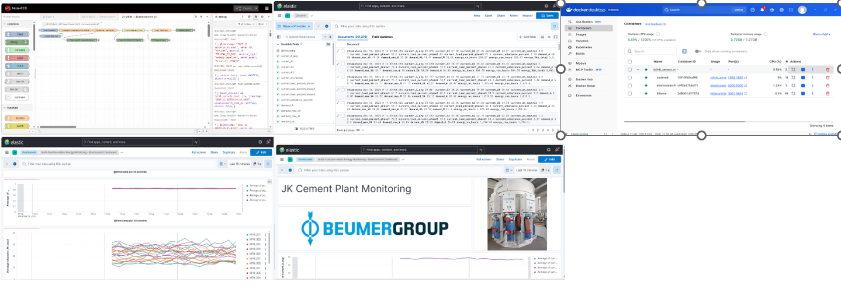
SLIDE 2 – 6 WEEK AUTOMATION TRAINING SUMMARY (PART 1)
Week 1: Automation & Digital Foundations
Introduction to BEUMER Group & global automation solutions
Overview of BHS (Baggage Handling Systems) & PMS
Basics of software, networking, servers & security
Introduction to AI & data analytics in automation
Data Analytics Mini Project
Simulated MFM energy meter data using Node-RED
Stored time-series data in Elasticsearch
Visualized power, voltage & current in Kibana dashboards

Slide 9
Week 2–3: Networking & Security
IPv4 & IPv6 addressing concepts
LAN design using Cisco Packet Tracer
Router & switch security basics
VLANs, STP & campus network design
Week 4–6: Servers & Software
Physical & virtual server infrastructure
SAN & virtualization concepts
OOPs, web development & REST APIs
Integration of networking, servers & applications

Slide 10
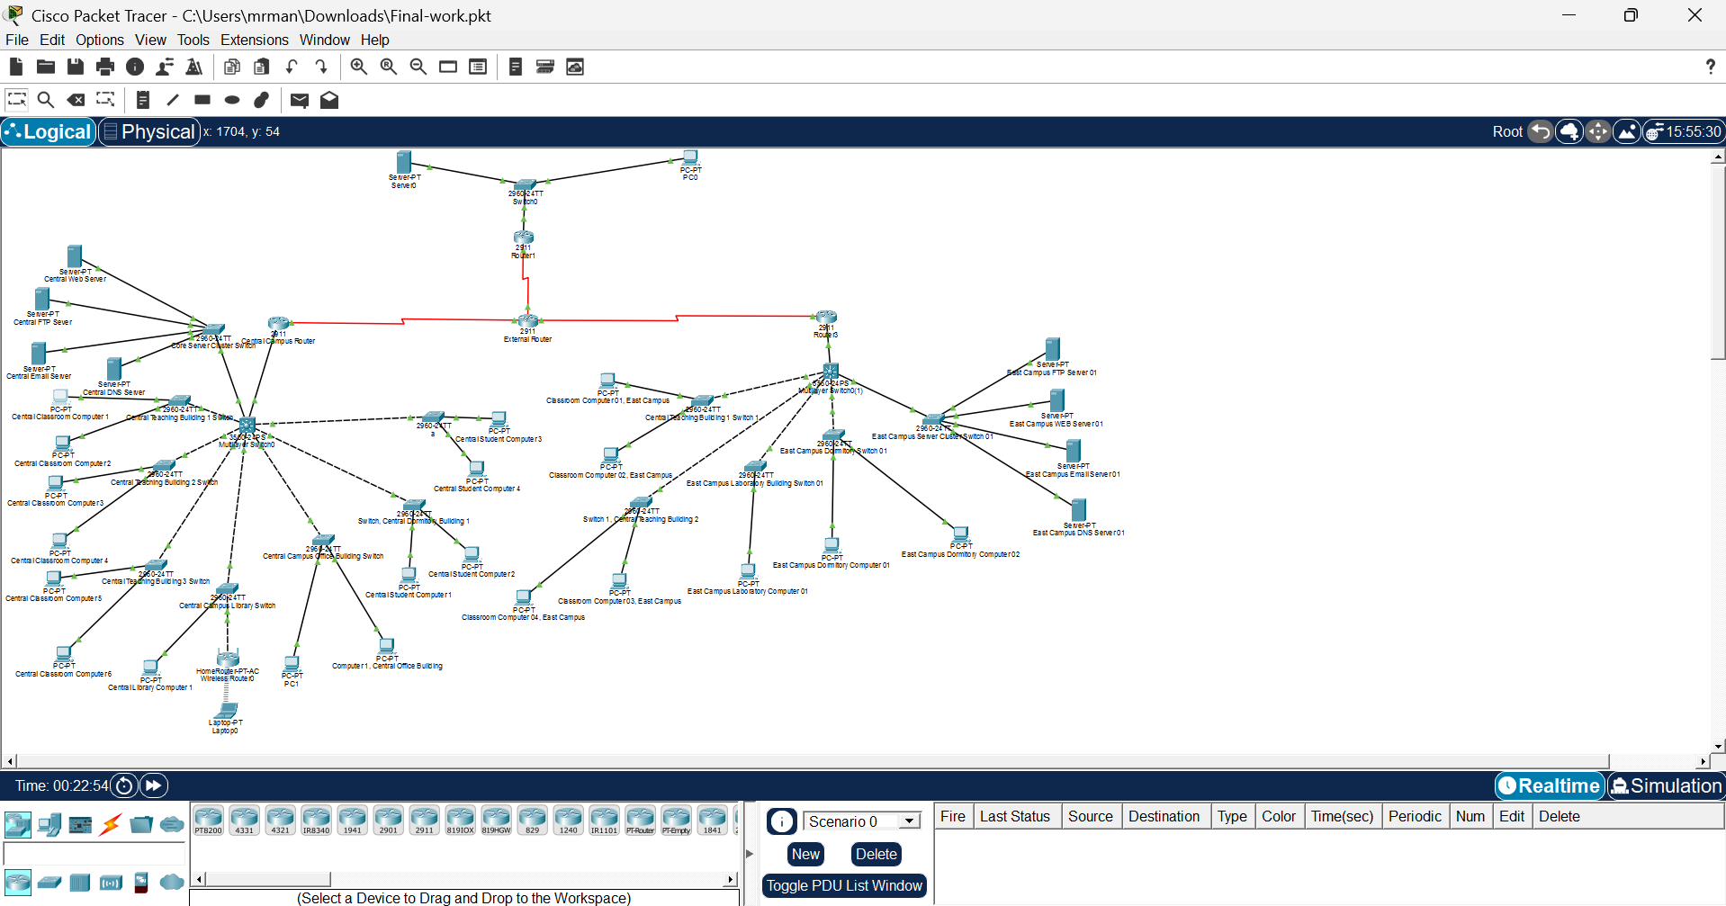
PROJECT 1: CAMPUS NETWORK DESIGN
Tool: Cisco Packet Tracer
Project Overview
Designed a multi-campus network (Central & East Campus)
Implemented routers, switches, servers & end devices
Key Features
Hierarchical network topology
DNS, Web, Email & FTP services
Inter-campus routing & connectivity
Learning Outcome
Practical routing & switching
Enterprise-level network simulation

Slide 11
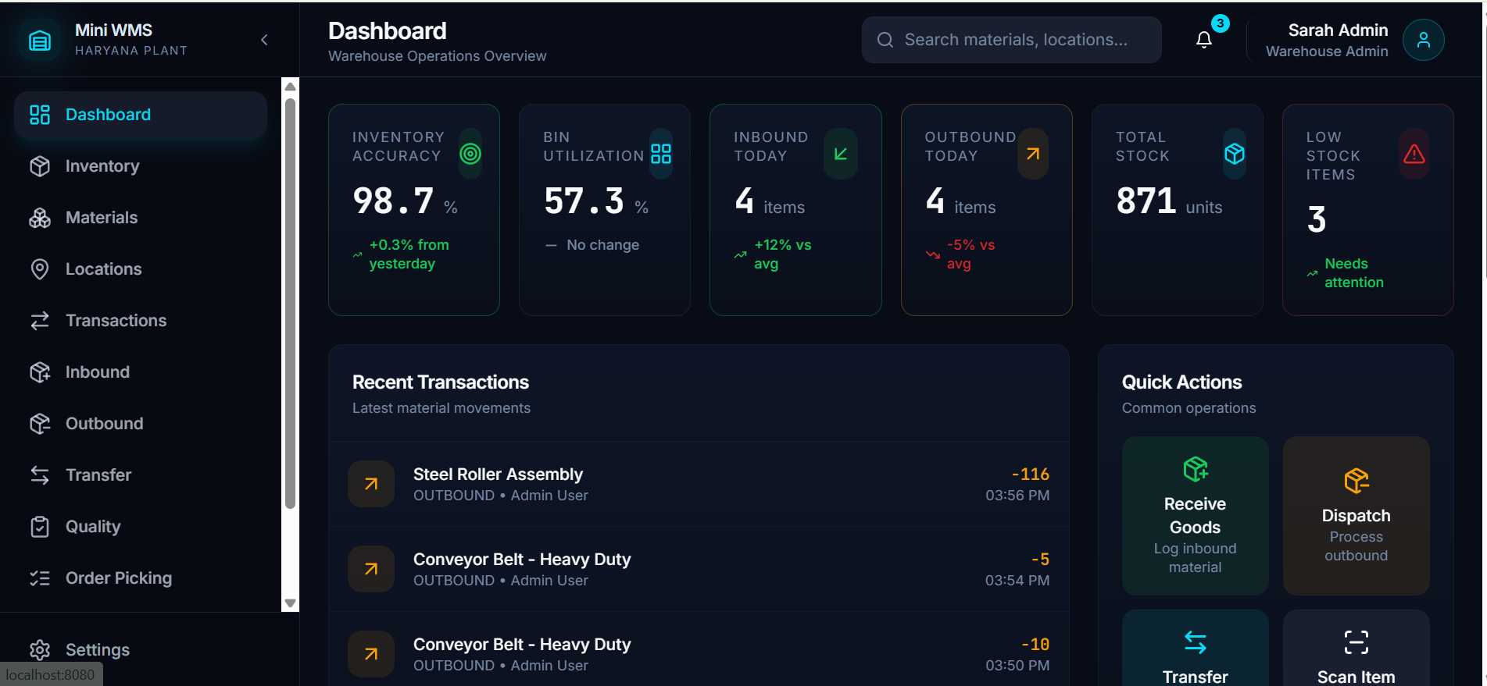
PROJECT 2: SMART STOCKFLOW (WMS)
Client: BEUMER Group – Haryana Plant Technology Stack: MERN (MongoDB, Express, React, Node.js)
System Highlights
Inventory & material management
Role-based access control (JWT)
Real-time dashboard & transaction tracking
Business Impact
Improved inventory accuracy
Reduced manual errors
Scalable & automation-ready architecture

Slide 12
THANK YOU
I sincerely express my gratitude to BEUMER Group for providing me with the opportunity to complete this internship and gain valuable hands-on experience in
Automation and Digitalization.
Special Thanks To
All Departments & Organization Teams – for their continuous support and cooperation
Training Manager:Mr. Kannan Sir
Mr. Ganesh Nayak(Digitalization) – for technical mentorship and guidance
Mr. Anne Sravan (Digitalization) – for insights into digital transformation and project guidance
Mr. Giresh (Automation) – for automation system knowledge and support
Mr. Shivam Singh (Automation) – for networking, automation training, and project guidance
Their guidance, encouragement, and support were instrumental in the successful completion of this internship.

